Slide 1
Software Engineering Processes (sometimes called SE lifecycle)
Important
What it is: Activities leading toward production of SW “product”
Relatively young field and not well understood nor manageable like other industrial production processes
Involves great deal of judgment, creativity, but also experience and methodology.
SW Engineering is somewhere between art and industrial process
Efforts to automate and use “silver bullet tools or processes” failed
It involves great deal of human interaction, teamwork and communication and is often messy
Some successful patterns and “best practices” are emerging – need to know them (what they are and how and when to implement them)
Increasingly asked in job interviews
More critical for success of team projects than technology
Copyright D. Petkovic

Slide 2
SW Engineering Process Components
Important
There are several basic components in building a SW product that need to be addressed in all SW Engineering methodologies:
  SW Requirements and Specification: functionality, constraints, look and feel, GUI, performance
  SW design
  SW implementation
  SW testing, validation: QA, usability
  SW evolution: operation, maintenance, (and fixes) to meet customer needs – often majority of SW life-time
  These components are applied in different way and order depending on needs, project phase, and chosen high level SE process or project management
Copyright D. Petkovic

Slide 3
High level SE Process or project management (PM) aspects
Important
There is also a high level project management (PM) aspect determining the way the whole project is executed (meetings/organization/communication, way the above components are followed and implemented: formally/iteratively/agile etc.)
  Structured/strict (e.g. formal in large companies or government specified)
  Unstructured (e.g. loose, very small teams, early stages)
  Semistrutured
Extreme, formal/Gov. specified; agile/SCRUM
Copyright D. Petkovic

Slide 4
SW Process Models (or Methodologies)
Important
Abstract representations of overall development of SW - methods and practices for organizing the SE effort
  Waterfall
  Evolutionary
  Iterative
  Open Source development
  Extreme programming
  For GUI and usability: User Centered Design (UCD) – variation of iterative development
Agile, Scrum – high level project management (PM) processes used to “manage, organize and implement ” the above SE processes
Copyright D. Petkovic

Slide 5
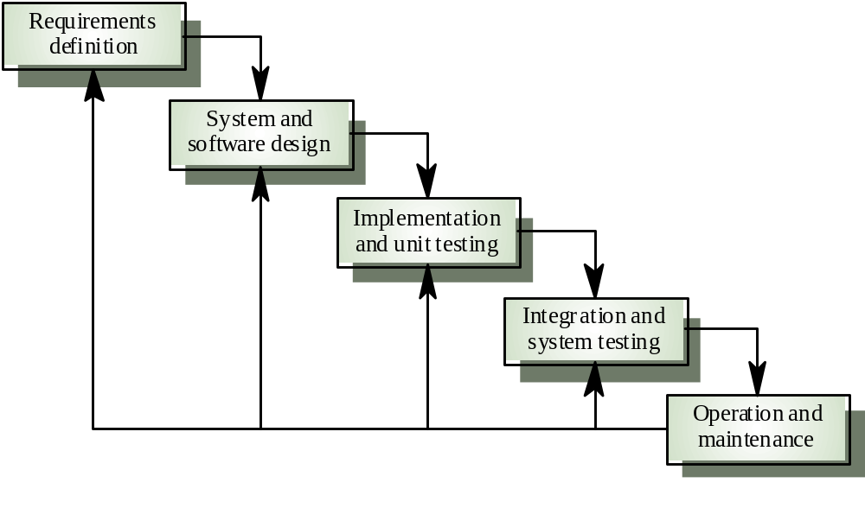
Waterfall model
Important
From: Ian Sommwrville

Slide 6
Waterfall Model Phases
Important
Requirements analysis and definition: services, constraints and goals are established by consultation with system users. Defined and used to guide all other steps
System and SW Design: Partition requirements into HW and SW systems. Establish overall systems architecture. Define fundamental SW abstractions and relationships
Implementation and Unit Testing: SW is implemented and unit testing is done on each SW unit
Integration and system testing: Program units are integrated and tested as a whole to validate their conformance with requirements. Delivered after successful testing
Operation and maintenance: System installed and used. Errors being corrected. Implementation improved. Some functions added as necessary
Copyright D. Petkovic

Slide 7
Waterfall and other models: some history
Important
David Parnas, Paul Clements, 1986:
  A system’s users seldom know exactly what they want and cannot articulate all they want
  Even if we could state all the requirements, there are many details that we can only discover once we are well into implementation
  Even if we knew all these details, as humans, we can master only so much complexity
  Even if we could master all this complexity, external forces lead to changes in requirements, some of which may invalidate earlier decisions
Copyright D. Petkovic

Slide 8
Waterfall and other models: some history
Important
Late 1980 DOD review:
  75% of Waterfall projects failed or were never used. Only 2% were used
1995 Microsoft publicized daily build and smoke test, a very influential incremental and iterative SW development practice
In 1994 and later DOD started replacing Waterfall standard with more flexible methods allowing iterative and incremental approach
Iterative approaches recently called Agile SW Development, see the same IEEE issue devoted to this
Copyright D. Petkovic

Slide 9
Evolutionary development
Important
Develop initial implementation
Expose it to users
Iterate (requirements, design, implementation) until satisfactory result is obtained
Rather than having separate specification, development and validation, these are carried out in parallel, with quick feedback and iteration
Copyright D. Petkovic

Slide 10
Evolutionary development
Important
Exploratory development: work with customers starting from parts of the system that are well understood. Add new features proposed by customer until final product is delivered
Throw-away prototyping: Experiment with customers using prototype. Results used to develop better and final system. Prototypes thrown away. Final system reimplemented
Copyright D. Petkovic

Slide 11
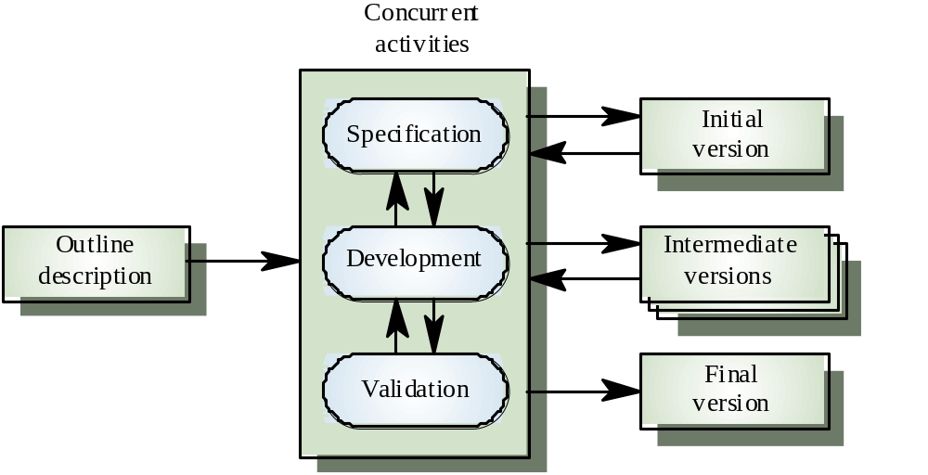
Evolutionary development
Important
From: Ian Sommerwille

Slide 12
Evolutionary development
Important
Issues and problems?
  Can result in “spaghetti code and architecture” since increments are patched together from the start. OK in the beginning, but often results in poor scalability and maintenance
Applicability?
Copyright D. Petkovic

Slide 13
Incremental Development
Important
Waterfall model requires early commitment to requirements before design and before user experience. But, it is easy to manage and track.
Evolutionary method helps in delaying some requirements until users get experience, but may result in poorly structured system because no general architecture is developed first
Incremental model is a compromise
Customers identify increments in development and prioritize them.
➔Architecture is designed early with future requirements in mind
Increments are developed and one by one integrated and validated. Each increment can use different SW Engineering model
Copyright D. Petkovic

Slide 14
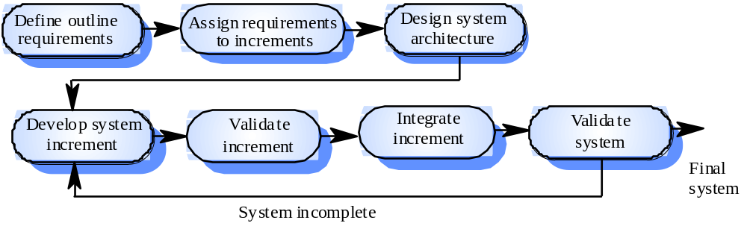
Incremental development
Important
This is done early
and it helps!
From: Ian Sommerville

Slide 15
Extreme Programming
Important
Develop final system in very small (a few week) increments
Apply planning iteratively, all the time, along with all other phases
Each increment contains all steps of full SW process but the scope is very small so it should be manageable
Most decisions developed by a team
Product initially has only a few features, but they can grow
Prioritize features so as to work on most important one at each time
Constant iterations among the team and with customers in small chunks. Very frequent build and test (daily?)
Programmers work in pairs
Copyright D. Petkovic

Slide 16
eXtreme Programming (XP)
Important
A discipline of software development that is
  lightweight, efficient, low-risk, flexible, predictable, scientific, and fun way to develop software
  based on values of simplicity, communication, feedback and courage
Copyright D. Petkovic
Notes:
It works by bringing the whole team together in the presence of simple practices, with enough feedback to enable the team to see where they are and to make adjustments to their practices.

Slide 17
eXtreme Programming (XP)
Important
Everything in XP is done in small steps:
  Easy to plan
  Easy to perform
  Easy to evaluate
  Easy to undo
“Small steps” supports simplicity, feedback, lowered risks, predictability and flexibility
Copyright D. Petkovic
Notes:
Small steps are easy to plan, easy to perform, easy to evaluate and most importantly, small steps are easy to undo.
Small step philosophy supports

Slide 18
XP (cont.)
Important
Each small step taken is completely resolved before taking the next small step
System always:
  compiles
  runs
  correctly performs it’s processing
“always” supports efficiency, lowered risks, flexibility, and fun
Always have a working product (daily build…)
Copyright D. Petkovic
Notes:
With this approach, the system always compiles, always runs and always correctly performs it’s processing.
Fun because you always have a working product.

Slide 19
Whole Team
Important
Remove artificial barrier between customer and development team
  Client becomes a part of the team
  Client makes critical decisions on the direction of the development team
Win - Win
Copyright D. Petkovic
Notes:
XP tells us to remove the artificial barrier between customer and the development team.
The client becomes a part of the team and makes critical decisions on the direction of the development team

Slide 20
Simple Design
Important
Design is always as simple as the current level of functionality allows
NO extraneous complexity needed or allowed
Keep the incremental design simple
  Design must extend only far enough
  Must encompass the next iteration’s added features
When code becomes cumbersome, it’s time for refactoring
Copyright D. Petkovic
Notes:
The design of the system is always as simple as the current level of functionality allows.
No extraneous (unrelated or irrelevant) complexity is needed or allowed
To Keep the incremental design simple, the design must extend only far enough to
encompass the next iteration’s added features
When code becomes cumbersome, it’s time for refactoring (weird and bulky).

Slide 21
Small Releases
Important
Tested & working code, whose functionality is specified by the client is very frequently released
For every iteration, the client gets a new software
Client evaluates & use the current status to dictate the content of the next delivery
Copyright D. Petkovic
Notes:
XP development teams release tested & working code, whose functionality is
specified by the client very frequent.
Every iteration (typically every 2 weeks), the client gets a new software.
Client evaluates & uses the current status to dictate the content of the next delivery or a future iteration

Slide 22
Collective Code Ownership
Important
Team as a whole owns the system software (use code reviews to achieve this…)
Who originally wrote the code is most likely not remembered
Anyone can modify any code at any time without asking for permission
Revision control is definitely necessary
With XP, you shouldn’t expect your code to be in the same shape you left it and anything you find is fair game
Copyright D. Petkovic

Slide 23
Continuous Integration
Important
New system builds multiple times per day
At all times, regardless of level of functionality, system compiles, runs and passes all tests
New code must again meet the same criteria
Copyright D. Petkovic
Notes:
That means any code written must before being added to the system compile, run and pass all tests

Slide 24
Coding Standards
Important
Developed codes should not look like a mixture of different styles
Team will adopt and follow some coding standard throughout development
Particular standard is not nearly important as adhering to that standard
Copyright D. Petkovic

Slide 25
Practices of eXtreme Programming
Important
13 practices of XP
  Whole Team
  Metaphor
  Planning game
  Simple design
  Small releases
  Customer tests
  Pair programming
  Test-driven development
  Design improvement
  Collective code ownership
  Continuous integration
  Sustainable pace
  Coding standards
Underlined: important
components worth using
Copyright D. Petkovic
Notes:
There are 13 practices of XP, namely:

Slide 26
User Centered Design and Development for GUI (UCD)
Important
Usability and GUI design and development are the most people/user intensive area of SW engineering
Know and listen to user, customer, client
Iterate with user (and others) all the time, starting early
GUI is a lot of code (often 50% of total), requires a lot of thinking, great detail and a lot of testing
User involvement and constant iteration with users distinguish user-centered design & development from regular SW design & development
GUI development is very rewarding: everybody sees quickly what you did (for better or worse ☺ )!
Copyright D. Petkovic

Slide 27
User-Centered Design and Development
Important
Conceptual design, prototype,
Specs, style guide
High-level design,
Prototype, specs
Requirements
Plan
EVALUATE
(users, management,
Graphics, Support,
Sales, QA…)
Low-level design,
Prototype, specs
Req. met?
Done!
Code and unit test
System test
From: R. Torres

Slide 28
Open Source Initiative
Important
All approved licenses must follow the Open Source Definition (excerpt from the 10 clauses):
  Free Redistribution
  Source Code available
  Derived Works allowed
  No Discrimination
http://www.opensource.org/docs/osd
Copyright A. Puder

Slide 29
Conclusions on Open Source
Important
Open Source communities can deliver industrial strength software
Open Source will not replace Closed Source
Different licenses emphasize different philosophies:
  GPL: emphasizes community aspect
  BSD: attribution of work is sufficient
Companies are getting less afraid of using Open Source
Business models are developing
Growing in importance and applicability
Copyright A. Puder, D. Petkovic

Slide 30
Summary
Important
We presented various SE processes/models that guide application of basic commonest (requirements, design, implementaion, testing…)
This is your “tool box” – each method works best for some cases. No silver bullet (except maybe UCD for UI)
In real application you will likely combine several methods
But, how does one organize such an activity at teamwork/project management level? This is addressed by higher level processes e.g. PM
Copyright D. Petkovic

Slide 31
Agile SW Development
Important
New movement started by well known people 2001
Agile SW Organization WWW site
  http://agilemanifesto.org/
SCRUM – variant of Agile (and XP)
Copyright D. Petkovic

Slide 32
Agile SW Development Principles
Important
Individuals and interactions over processes and tools
Working software over comprehensive documentation
Customer collaboration over contract negotiation
Responding to change over following a plan
Copyright D. Petkovic

Slide 33
SCRUM Process – variant of Agile but simpler
Important
About Scrum
  http://en.wikipedia.org/wiki/SCRUM
Tutorials:
  http://www.wiziq.com/tutorials/scrum
  http://www.brighthub.com/office/project-management/articles/6549.aspx
  http://pmstudent.com/scrum-in-under-10-minutes/
Highly recommended – it works
Copyright D. Petkovic

Slide 34
What we do in the class – M1-M5 and SCRUM
Important
Structure deliverables in 5 milestones to over req/specs, prototype, implementation, test and deliverables
Iterate all SE phases, use UCD for UI
Develop overall goals and task list (can be iterated and modified)
Then
SCRUM Inner loop – work on small “deltas”: Weekly meetings in class last hour (plus group meets more). Instructors ask 3 basic questions:
  What have you done vs. you plans since last meting
  What are plans till the next meeting
  Any issues/need help
SCRUM Outer loop: once a moth step back and look at overall progress and revise if necessary (instructors with the team,)
Copyright D. Petkovic

Slide 35
Waterfall model issues
Important
Pros:
  Easy to manage (from project management standpoint)
  Follow classic engineering approach
  First formal model, was part of many Military standards
Cons:
  Assumption that all requirements are known in advance is rarely true
  Inflexible partitioning of tasks
  Commitments have to be made early hence it is very hard to respond to changing or more understood requirements later in the process
  Poor success history
Applicability:
  Only when requirements are well known in advance and will not change
Copyright D. Petkovic

Slide 36
Evolutionary model issues
Pros:
  Meets immediate needs of customers
  Manages risks and uncertainty in requirements
Cons:
  System can end up being poorly structured for future upgrades because of step-wise additions
  Hard to track (too many documents for each iteration)
Applicability:
  Smaller systems (less than 100000 LOC) or medium system with short lifetime.
  Can use evolutionary to learn real requirements, then reimplement possibly using other SW methods
Important
Copyright D. Petkovic

Slide 37
Incremental development issues
Pros:
  Combines advantages of Waterfall and Evolutionary methods
  Architecture developed early with current and future requirements in mind ➔ ensures better scalability and maintainability
  Customer can get immediate value and experience
  Risk is lowered
  Most important functions are delivered first
Cons:
  Sometimes hard to decide what are good increments for the customer
  Some systems require a lot of basic functions in order to start to function
Applicability:
  Works for most systems
  Exception are some very strictly specified systems in terms of functions, reliability, safety etc. or where many functions have to be done in order for system to work
Important
Copyright D. Petkovic

Slide 38
Reuse-oriented development issues
Pros
  Reduces amount of SW to be developed ➔ reduces costs and risks
  Faster delivery of SW
  Good for Open Source and WWW Services
Cons:
  Requirements usually have to be compromised
  Further iterations of SW are problematic because SW is based on components developed by others
  Integration may be a problem if different component families used
  IP issues - always check the license, seldom is it really free
Applicability:
  NEW: Gaining given WWW and Open Source
  Research, exploratory or prototyping SW
  When rather standard functions are needed
  Changes can be implemented using someone else’s components
  When IP issues are resolved
Important

Slide 39
Extreme programming issues
Pros:
  Fast
  Effective for smaller projects and teams
  Can deal with rapidly changing or vague requirements
Cons
  New. Not proven on very large systems
  Requires very dedicated team
  Overall SW architecture may suffer
Applicability:
  Fast changing or vague requirements
  Small to medium projects, early prototypes, demos
  Early SW development, later may need to restructure
  Availability of highly motivated team
Important
Copyright D. Petkovic

Slide 40
User-Centered Design issues
Pros:
  Variant of iterative and incremental methods
  Puts users at the center of the decision making
  Reduces risks
Cons:
  Availability of cooperative users
  Requires investment to get feedback from large pool of users
Applicability:
  UI, usability intensive SW, also APIs and docs
Important
Copyright D. Petkovic

Slide 41
Analysis and comparisons among various SW development methods
As a practitioner, it is essential to know:
  Pros and cons of each method
  When to apply it and when not
  How to apply it effectively vs. resources, company policies, team skills etc.
While it is good to have favorites, it is not good to be inflexible about it
Important
Copyright D. Petkovic

